Slide 1






BYTE FORGE.
CONNECT X
INTELLIGENT AI-BASED AP MONITORING SYSTEM
Notes:
-

Slide 2
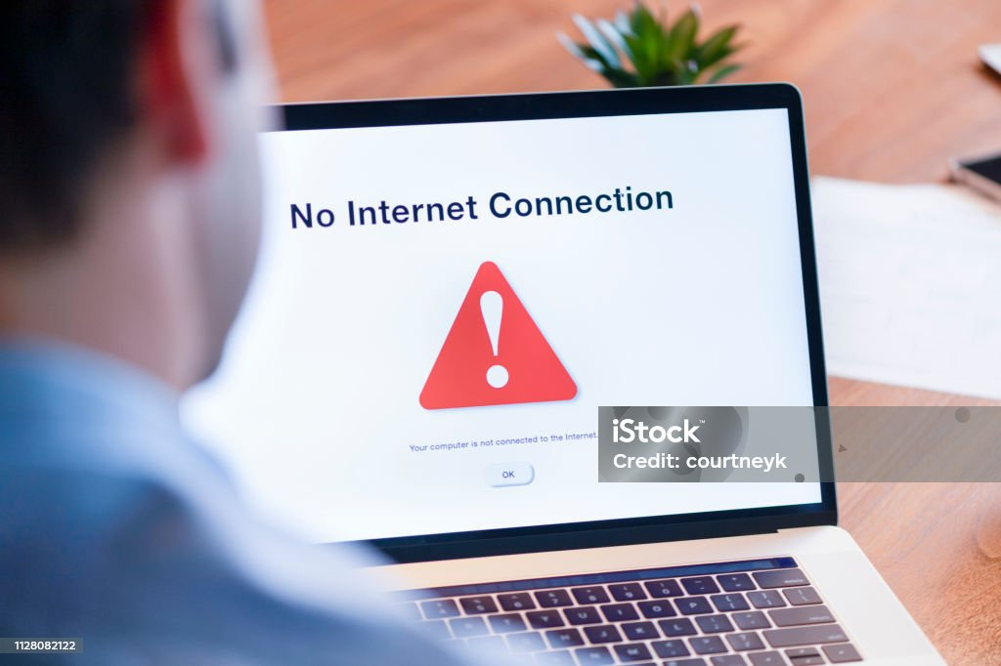
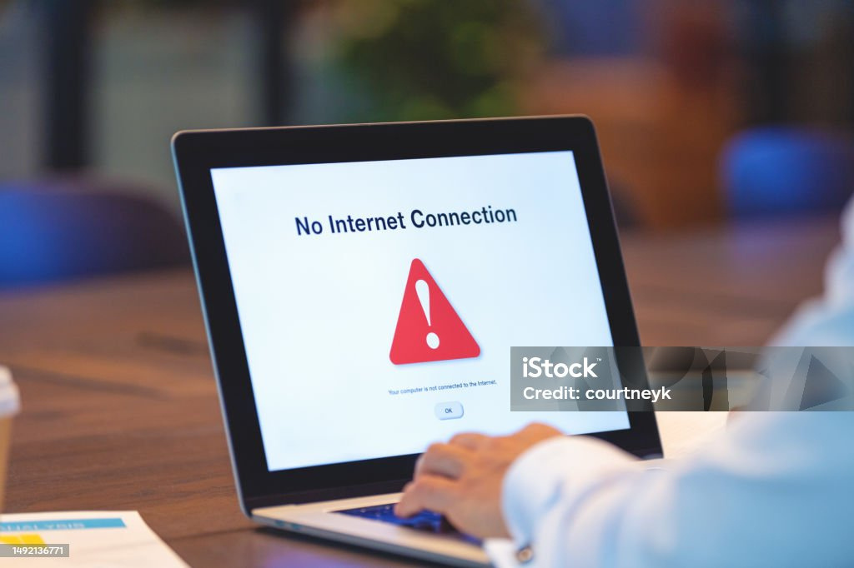


BYTE FORGE
CONNECTIVITY
CRISIS
IN UGANDA ,UNSTABLE INTERNET CONNECTIVITY REMAINS A SIGNIFICANT ISSUE
.MANY ACCESS POINTS (APs) FAIL SILENTLY ,DISRUPTING BUSINESS,EDUCATION AND COMMUNICATION.
INTERNET SERVICE PROVIDERS LACK REAL TIME VISIBILITY ON OUTAGES,CAUSING DELAYED RESPONSE

Slide 3

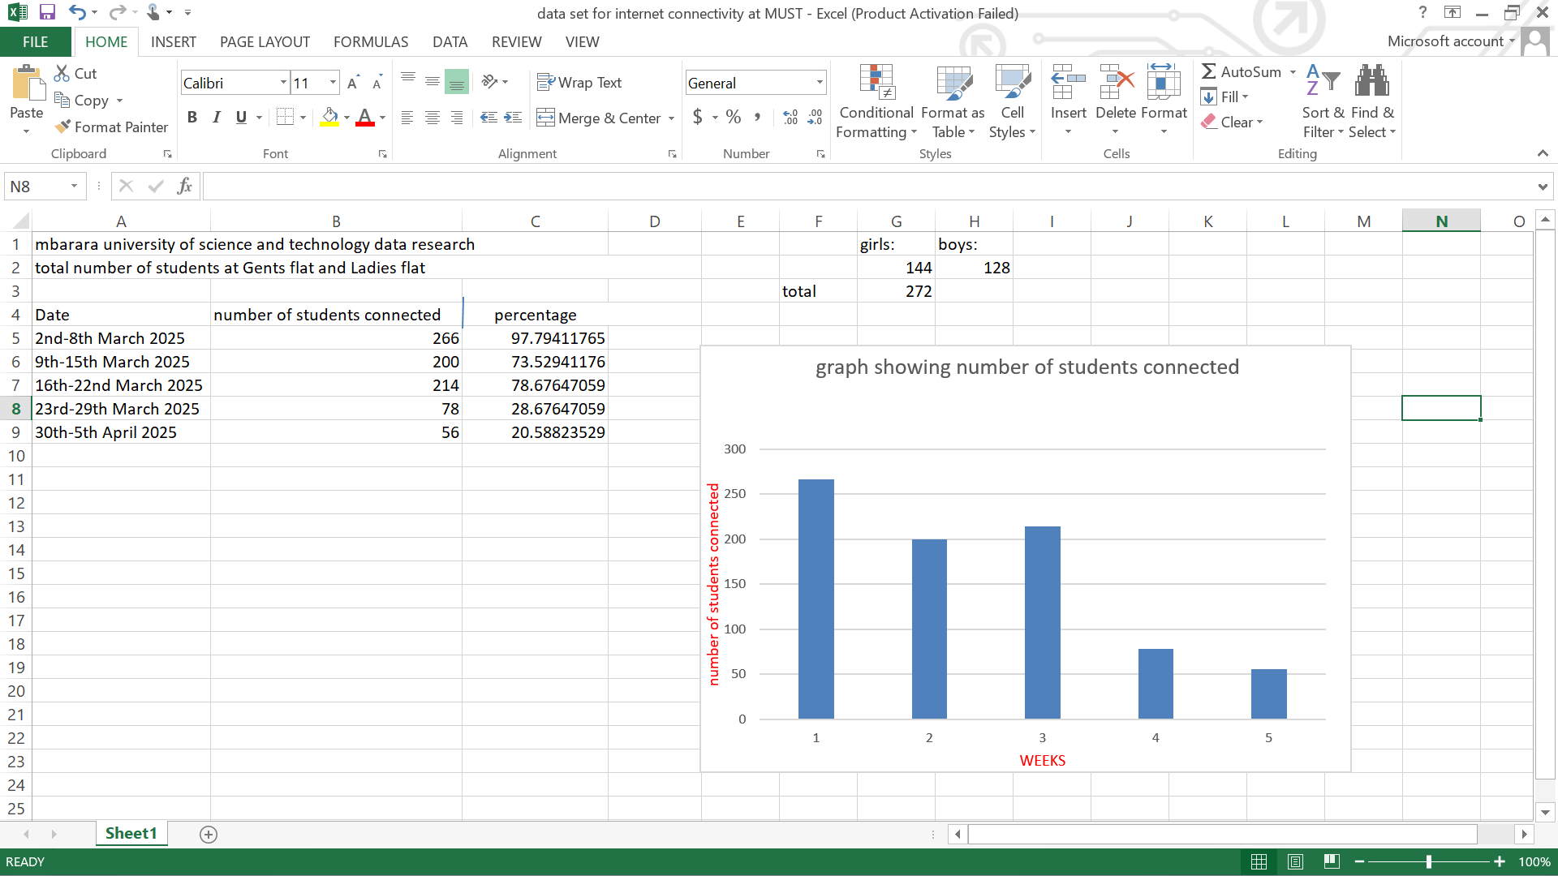
BYTE FORGE

Slide 4
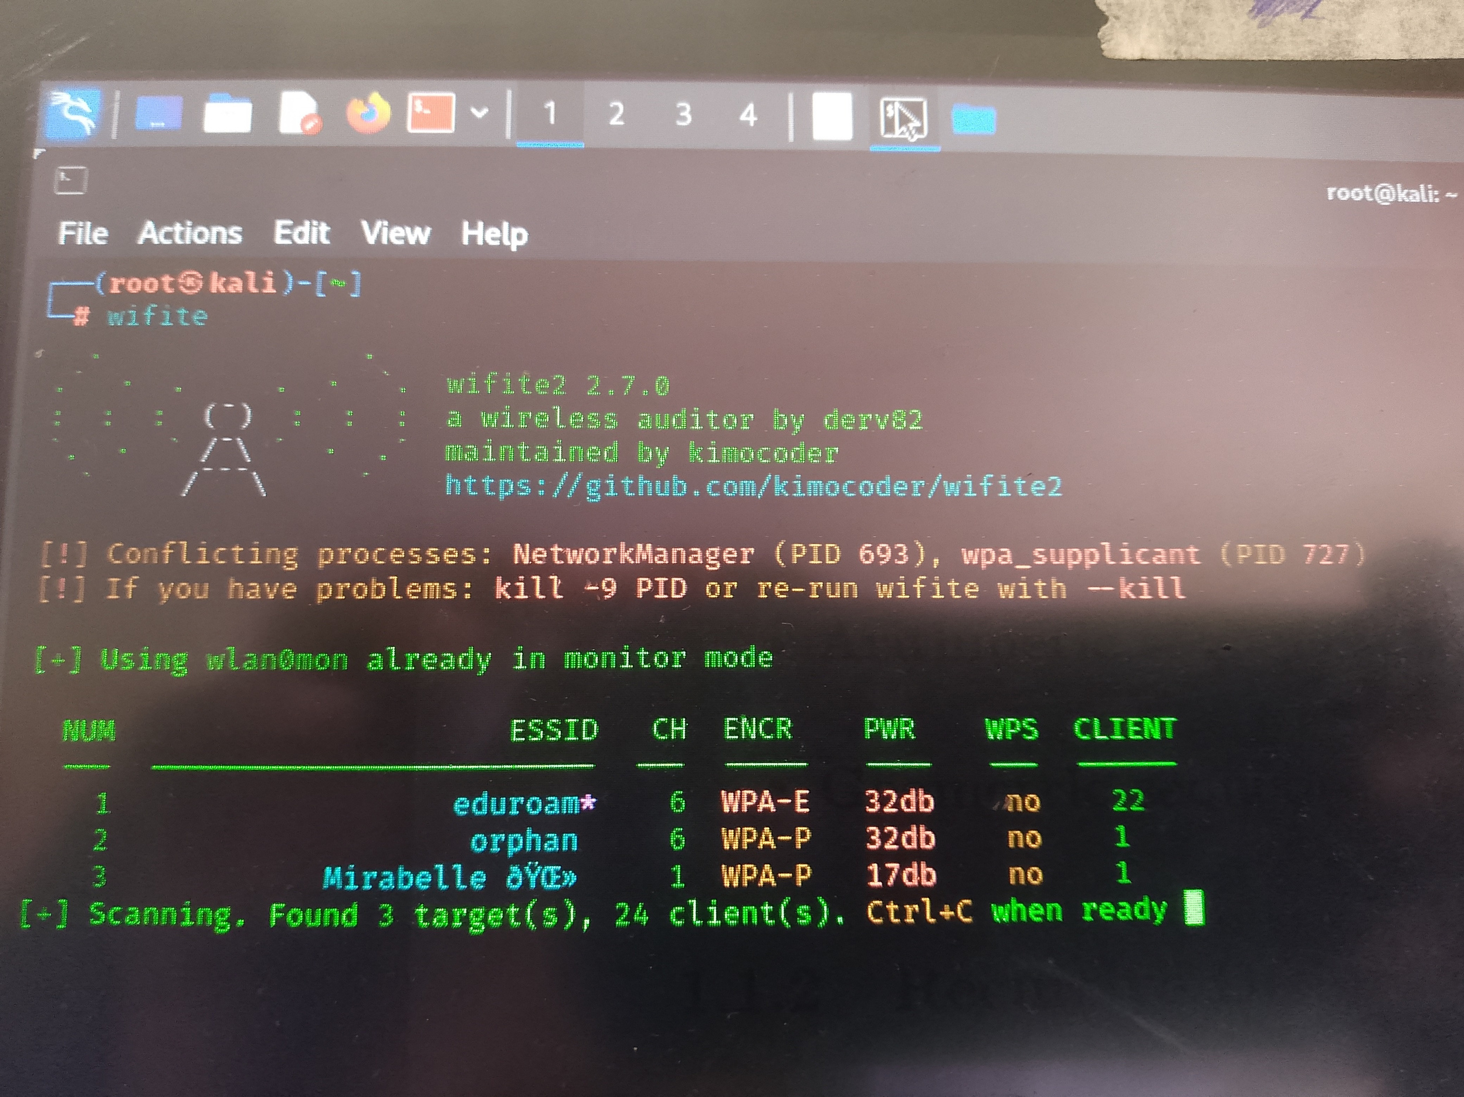

Slide 5
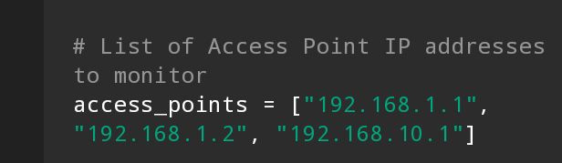
BYTE FORGE
CODE OVERVIEW
PURPOSE
Defines the IP addresses of APs that the system will monitor for connectivity

Slide 6
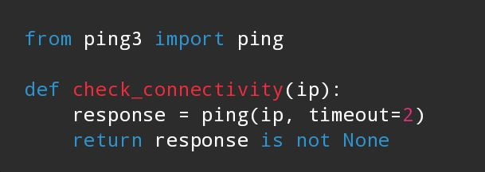
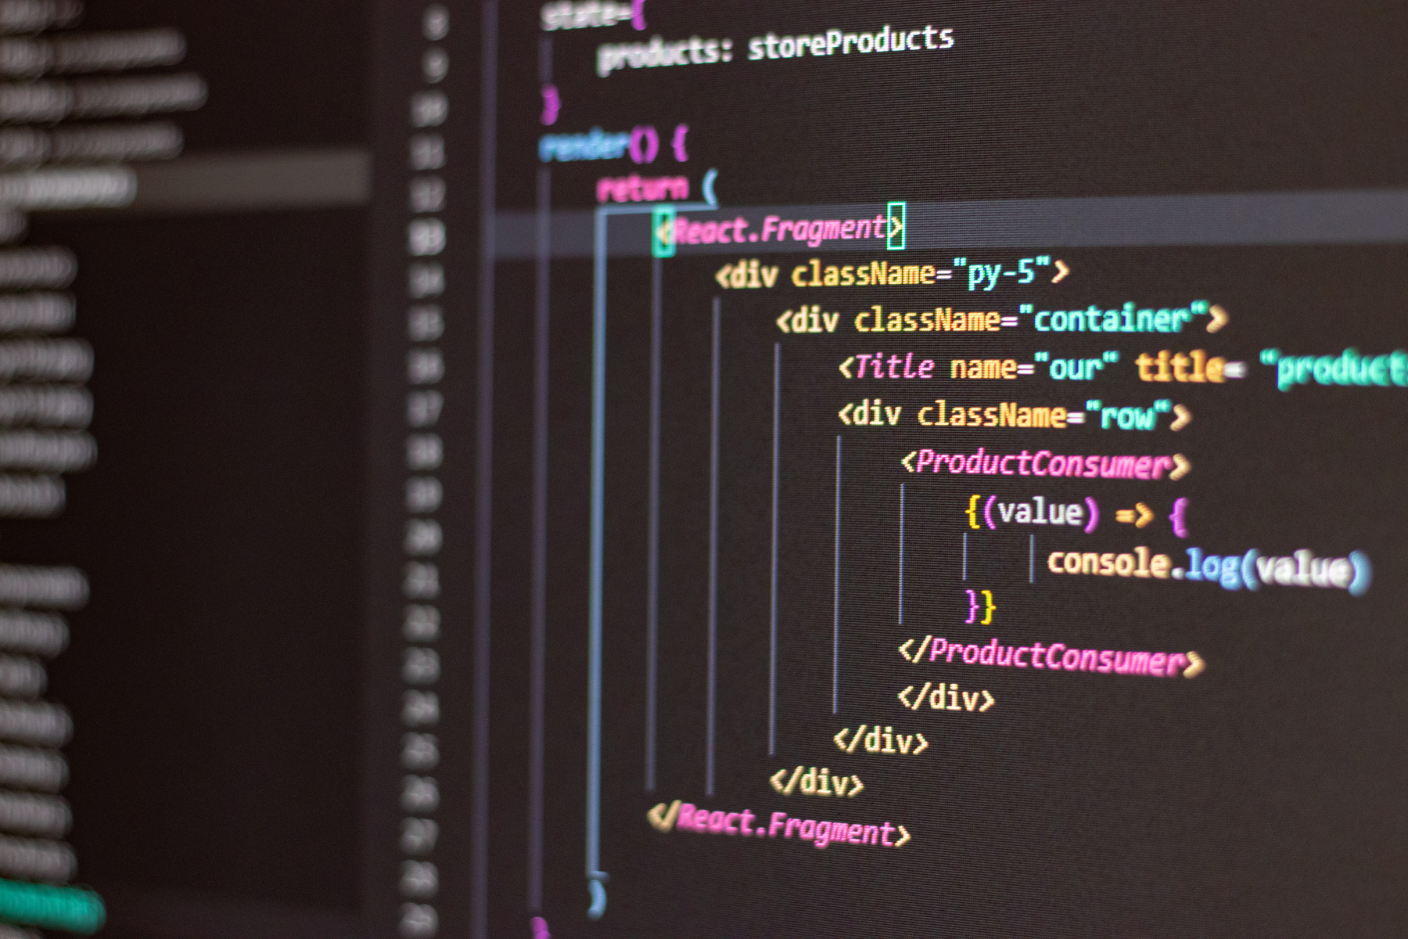
BYTE FORGE
uses the ping3 library to check if an access point is reacheable.

Slide 7
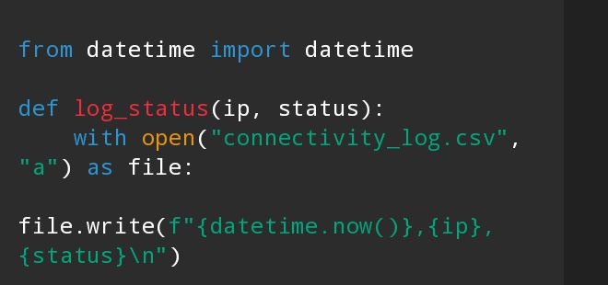
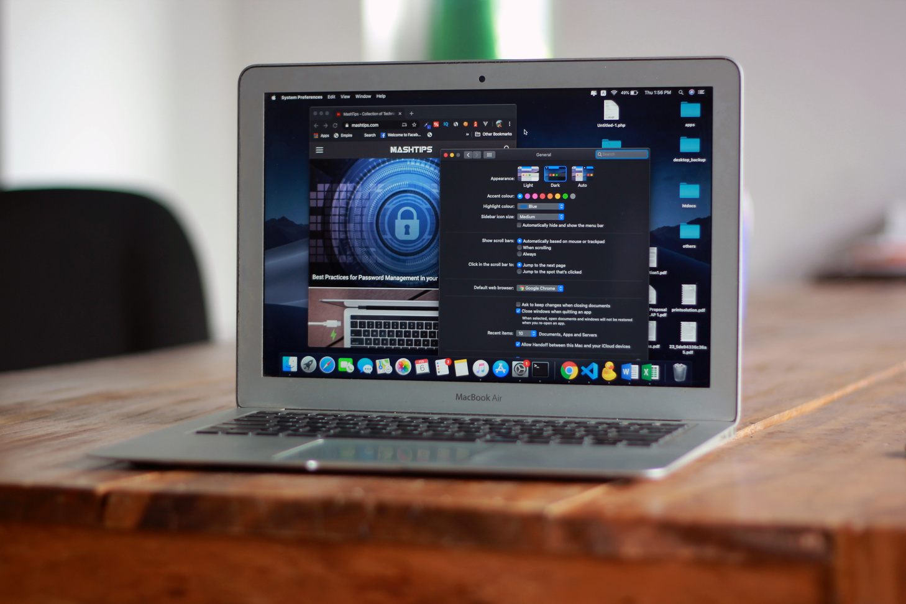
BYTE FORGE
Saves each ping result with a time stamp for monitoring trends and auditability

Slide 8
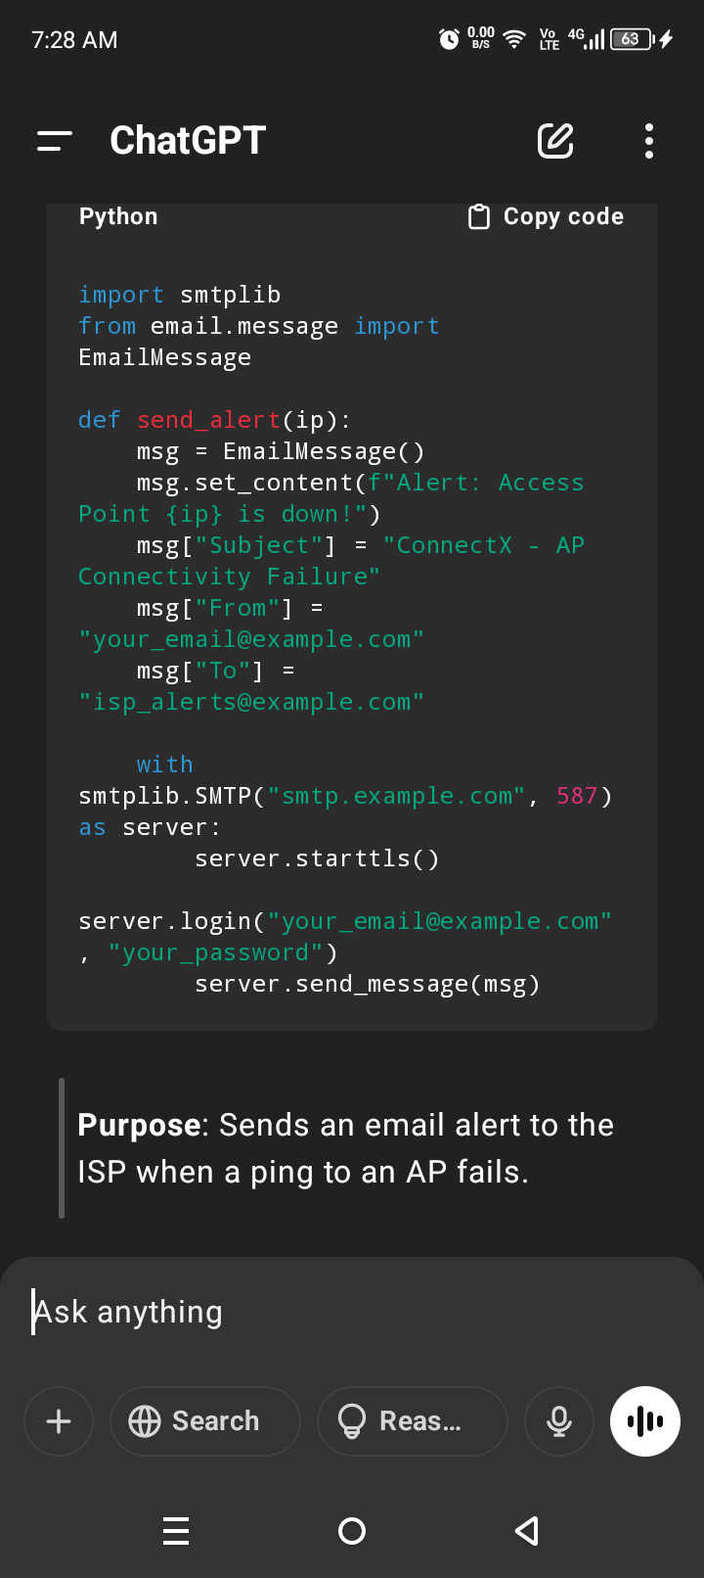

BYTE FORGE
Sends an email alert to the ISP when a ping to an AP fails

Slide 9
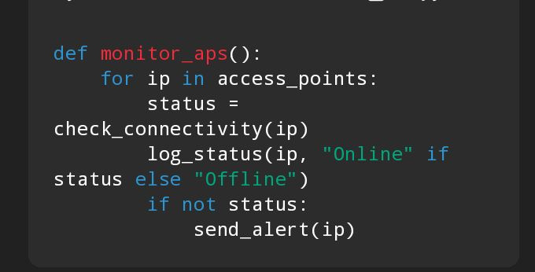

BYTE FORGE
CORE LOGIC THAT PERFORMS CONNECTIVITY CHECKS,LOGS,
RESULTS AND SENDS ALERTS

Slide 10
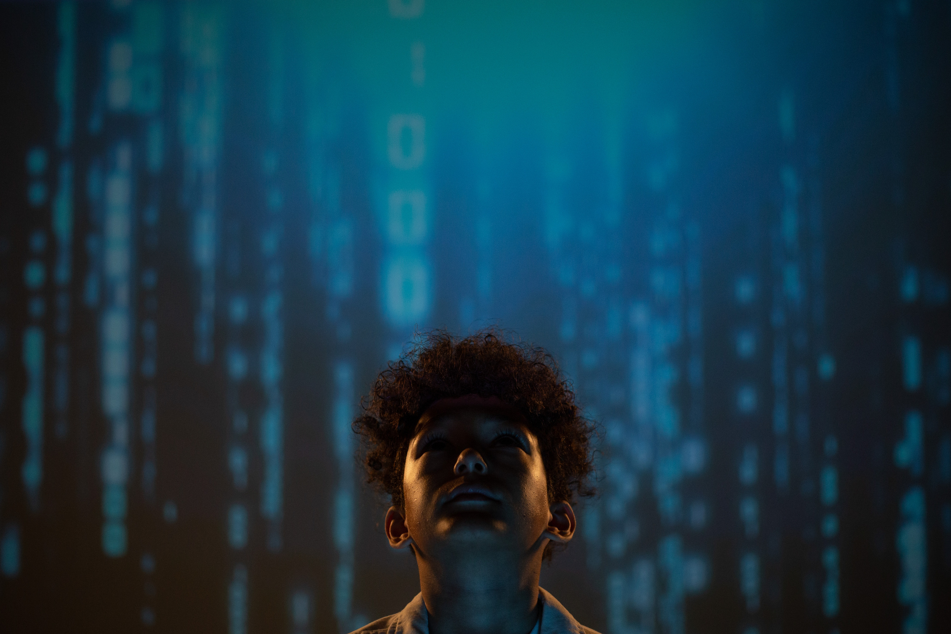
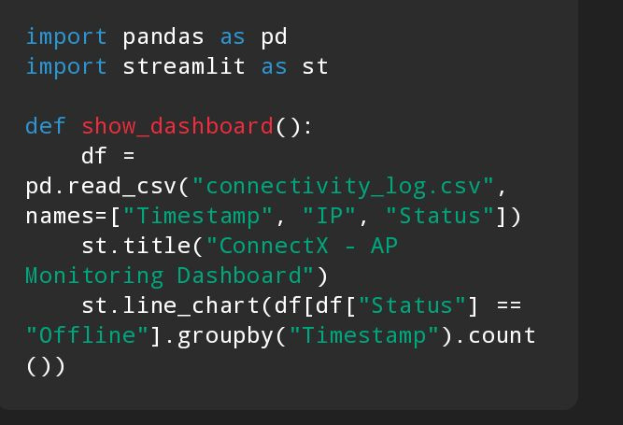

LARANA, INC.
VISUAL DASHBOARD
Displays areal time dash board with connectivity trends using STREAMLIT

Slide 11
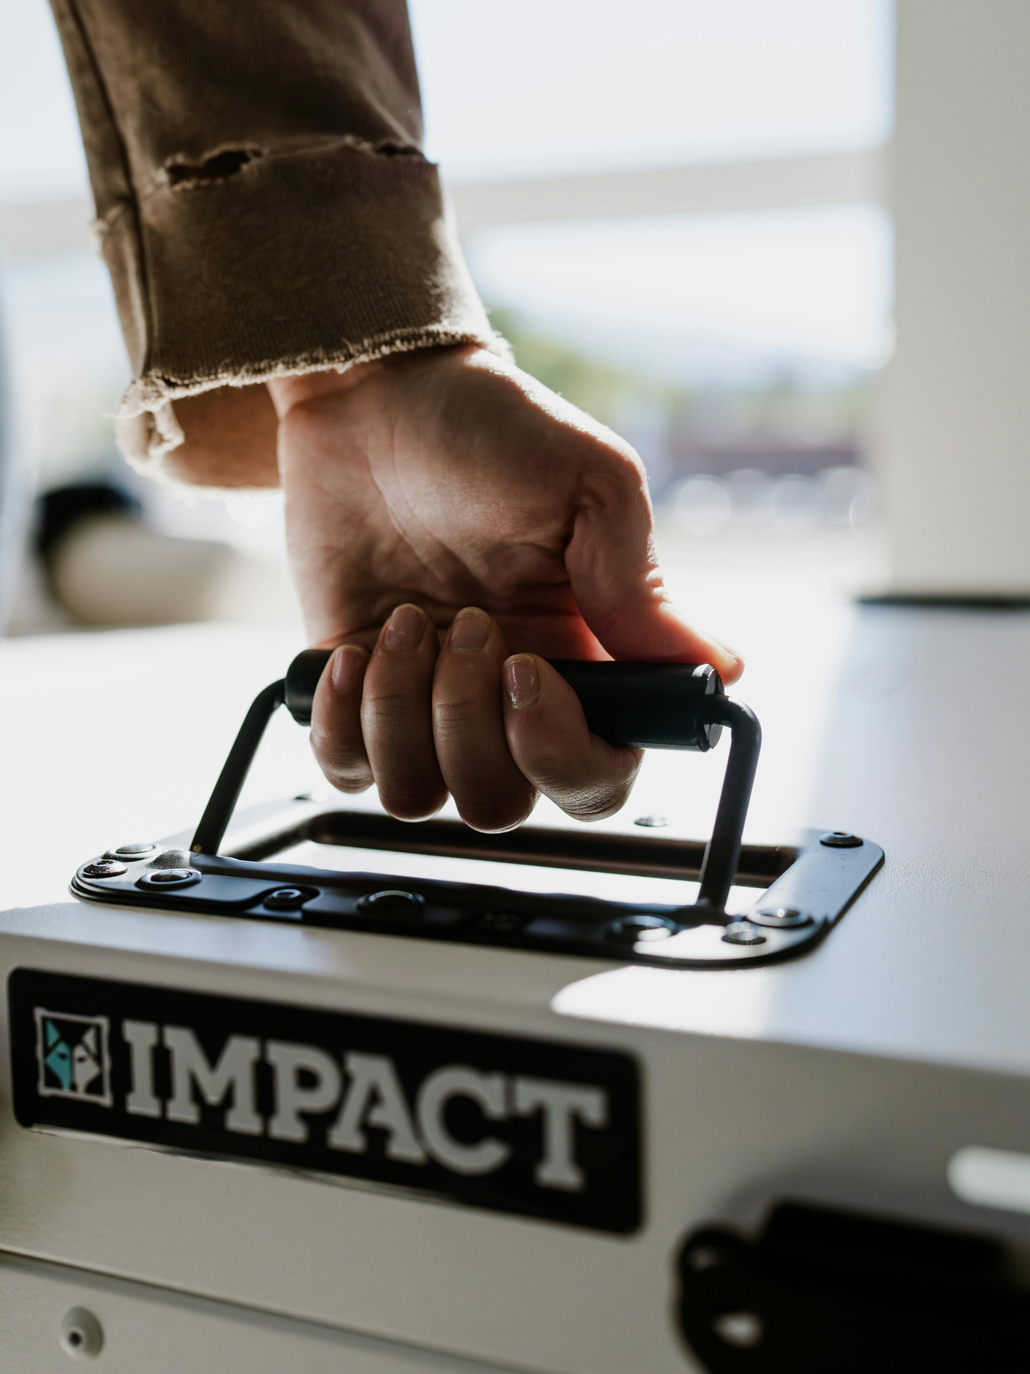


IMPACTS
Improved Internet Reliability
Enhanced ISP accountability
Empowered Users& Communities
Data-Driven Network Optimization
Cost and Time Efficiency

Slide 12


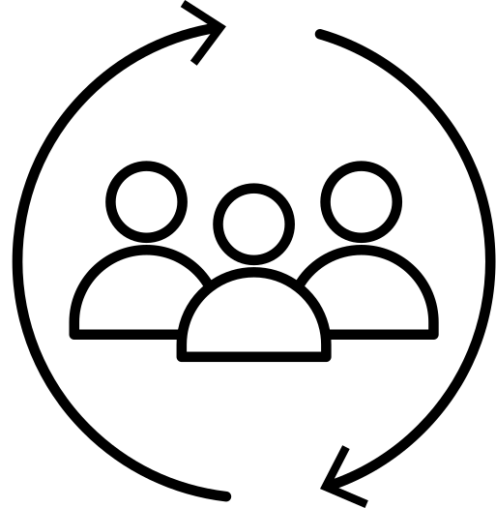
UVP(Unique Value Proposition)
AI-powered Real-Time Monitoring
Automated Alert System to ISP’s
Data-Driven Insight & Logging
Lightweight & Scalable
Tailored for Developing Regions

Slide 13
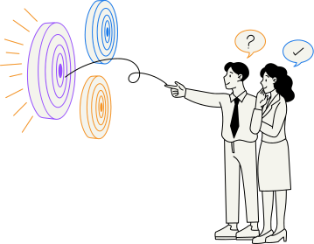








EDUCATION SECTOR
Target market &
early adoptants
CITIES
INDUSTRIES & INNOVATION

Slide 14
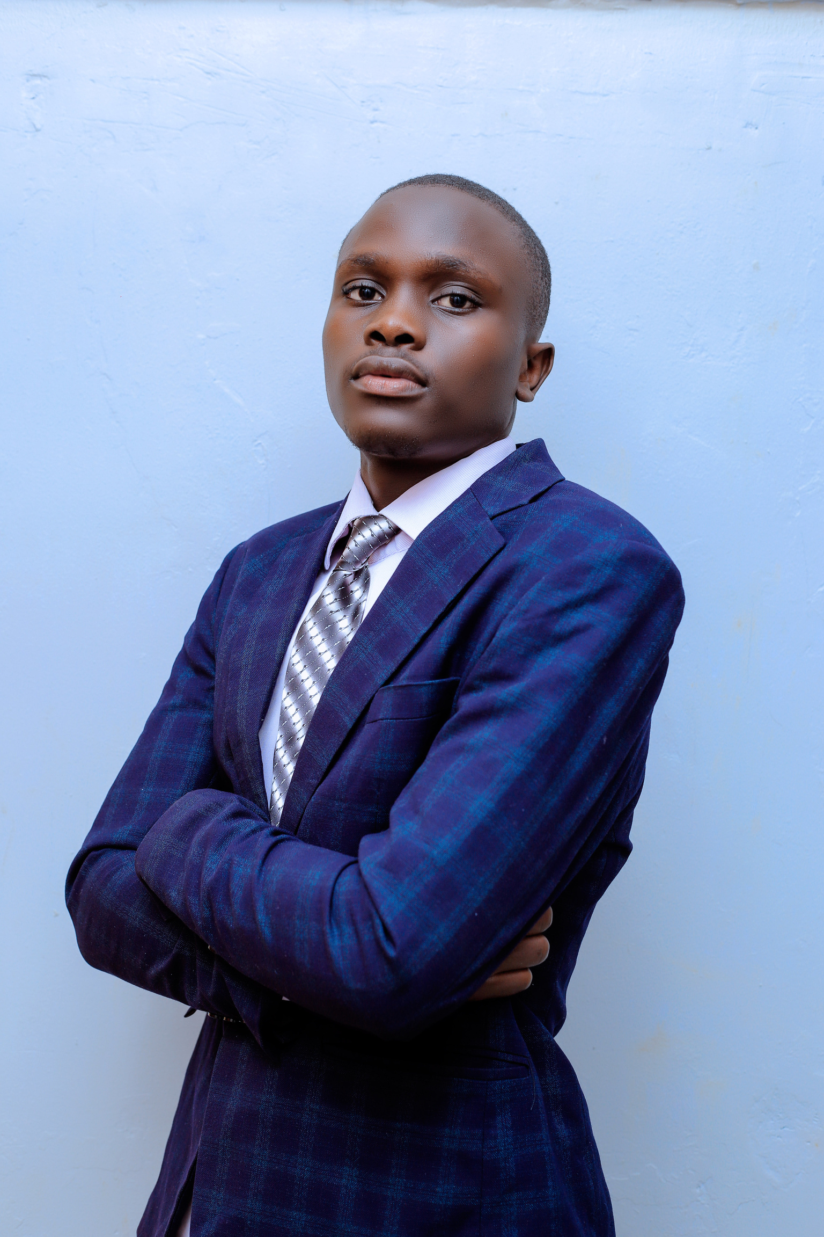
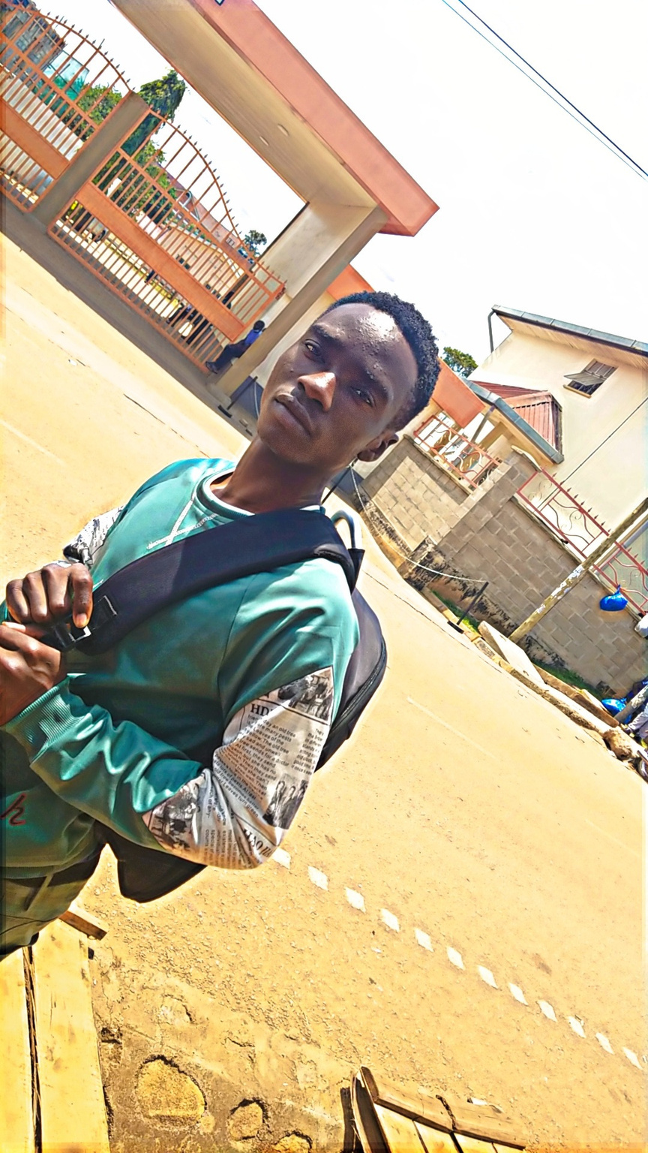
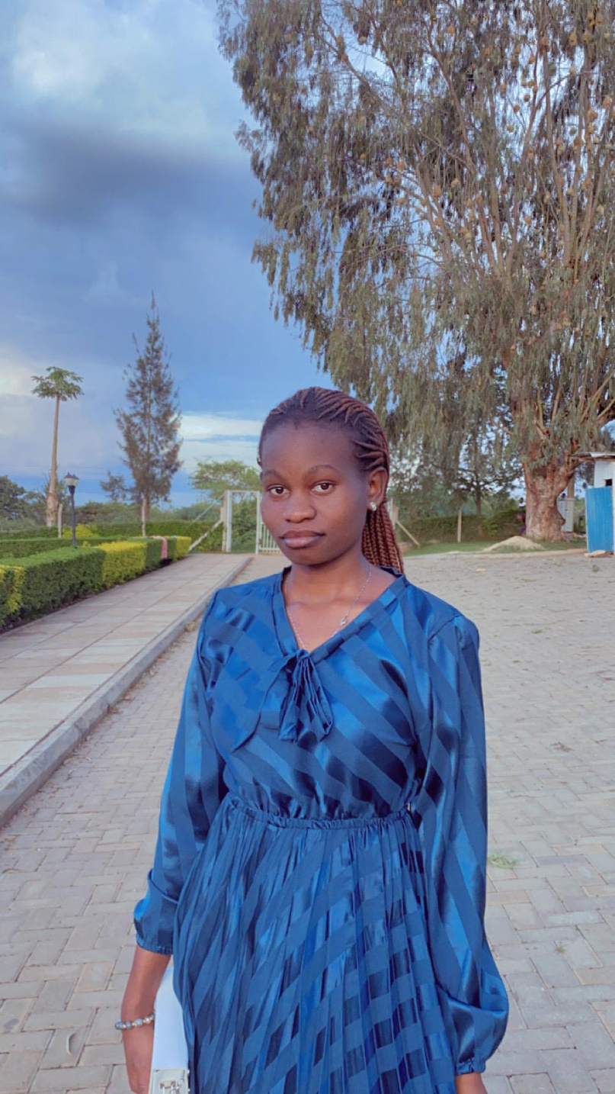
MEET THE TEAM
BYTE FORGE
ARONDA TREVOR ENOCK
BUKENYA CALVIN
NANKYA JOANITAH
UI/UX Designer & Outreach Lead
Role: Designed the user interface and managed user experience for the Streamlit dashboard.
Contribution: Handled front-end design, created graphics, and prepared the visual assets for both the app and the presentation.
Strengths: Visual design, user engagement, and presentation buildin
Architected the AI model and managed the overall system design.
Contribution: Developed the Streamlit app, coded the monitoring logic, and led the technical direction of the project.
Strengths: Python development, AI systems integration, and innovation-driven mindset.
Role: Designed the AI components, selected appropriate ML techniques, and handled dataset preparation.
Contribution: Worked on model training, testing, and performance optimization using real-world network datasets.
Strengths: Machine Learning, data preprocessing, and performance evaluation.

Slide 15






BYTE FORGE
GET IN TOUCH
Thank you for your time!
CONNECT X can revolutionize the monitoring of internet connectivity, and we are excited about the potential it holds for improving connectivity experiences.
THANK YOU
0758508914
WWW.CONNECTX.COM
arondatrevorenock@gmail.com
MBARARA UNIVERSITY OF SCIENCE AND TECHNOLOGY,KIHUMURO CAMPUS

